Slide 1
Phishing URLs
data mining and machine learning final project
Nimrod Levkovits
GitHub

Slide 2
Background
What is Phishing?
According to the Ministry of Justice: "A method of fraud, which by sophisticated means convinces the victim to enter his personal details, thus giving the offender access to the same personal details entered by the victim. That he is connected to a real website, such as his bank website, but in practice the page is not real and all the identifying information (username and password) that the victim enters passes to the offender. "
!

Slide 3

Research Questions:
Is it possible to identify a phishing site by its URL data?
Can we discover new patterns and conclusions from the gathered data?
Is it possible to improve the existing prediction?

Slide 4
Research Agenda:
Data Acquisition
01
API
Crawling
Data Cleaning
02
Concentration of the data
Filter duplicates and bad entries
EDA - Exploratory data analysis
03
Phishing Examples
Phishing URL Criteria
URL Heat Map
ML – Machine Learning
04
Decision Tree
Random Forest

Slide 5

01
Data Acquisition
Web Crawling
Three different sources:
urlhaus-api.abuse.ch – Database for phishing domains.
phishtank.com – Database for various malicious domains.
sites.google.com/site/top10000alexadomains/top-10000-alexa-domains - I used this database to acquire known legit domains

Slide 6

01
Data Acquisition
I used the ‘BeautifulSoup’ library to crawl the sources for their URL data.
I saved the legit URLs from ‘sites.google.com’ to ‘legit_urls.csv’.
The malicious URLs from ‘urlhaus-api.abuse.ch’, ‘phishtank.com’
I saved in ‘verified_online.csv’
Then I used ‘ipwhois’, ‘urllib’ libraries to get the required characteristics for the research.

Slide 7

02
Data Cleaning
Concatenation of all the data from the three sources and insertion to a table with uniform columns
Cleaning unneeded / unusable entries
Duplicates
Although there are billions of URLs and millions of malicious ones, there were some duplicates in the databases.
NULLs and bad entries
I came across some bad URL entries and URLs that did not have enough data (blank characteristics) to support using them in the research.

Slide 8
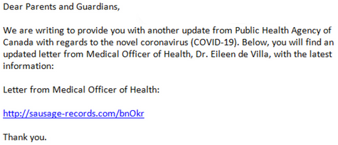
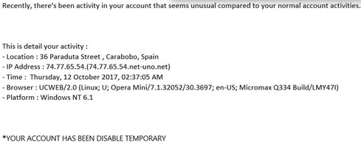
03
EDA – Famous Phishing
Fake Crisis Phishing:
Scammers use crises like the Corona and send malicious URLs to people under the guise of corona information
Deactivation Phishing:
An email containing a deactivation notice from a known organization unless you go to the site and enter your username and password.

Slide 9
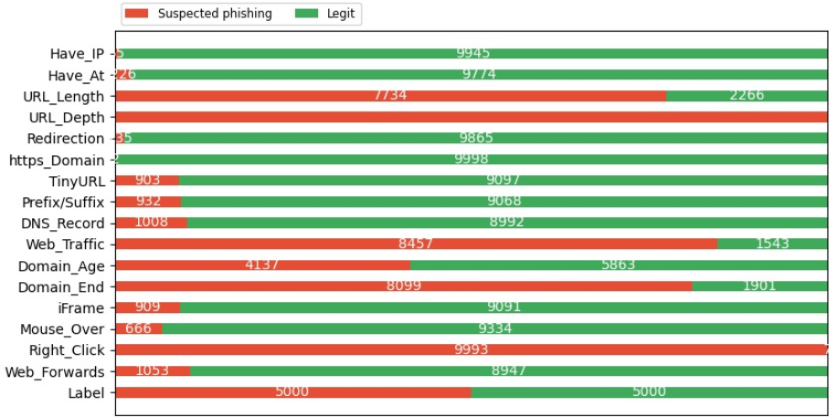
03
EDA – Phishing Categories
We can see the Most significant categories to identify phishing URLs
It is very surprising that the IP and At (@) categories don’t show many phishing websites as they usually the prime characteristics for a malicious site.

Slide 10
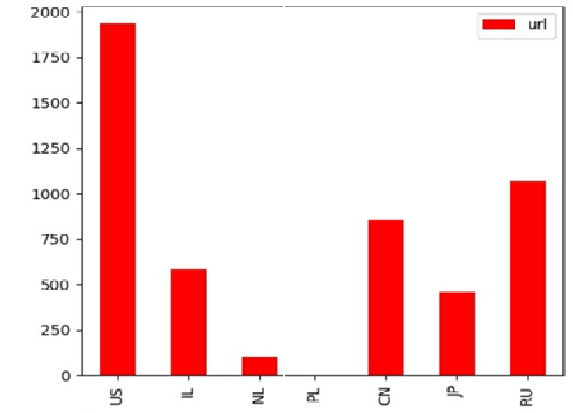
03
EDA – URL Heat map
We can see that 50% of the malicious URLs are concentrated within 5 countries.
It is not surprising to see these 5 countries since these are 5 cyber-power nations.
RU
US
JPN
JPN
IL

Slide 11
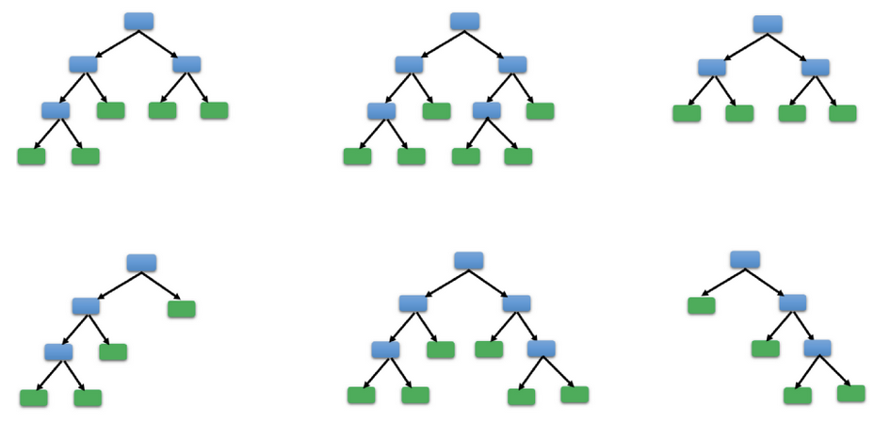
04
ML – Machine learning
In this project, I used two ML algorithms:
Decision Tree
Random Forest

Slide 12
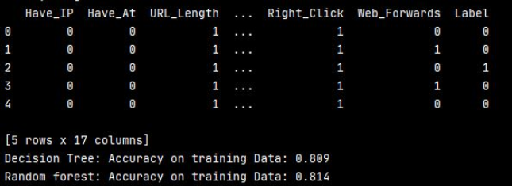
04
ML – Accuracy
We can see both Decision Tree and Random Forest have similar accuracy.
This is both expected and approves that the data is valid.

Slide 13
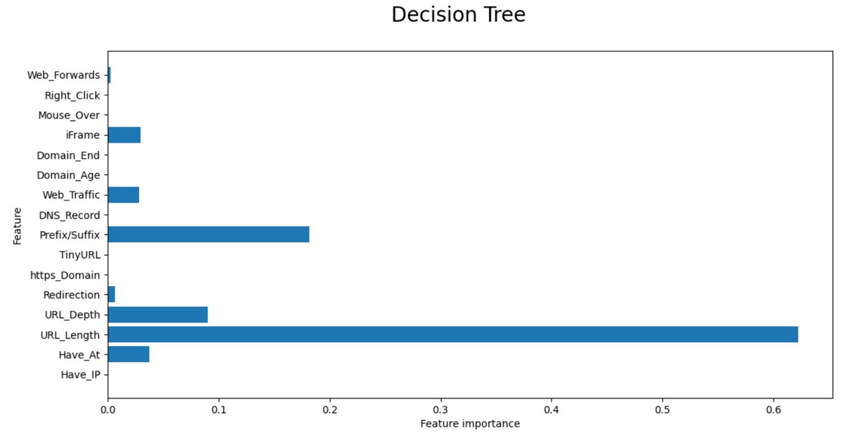
04
ML – Decision Tree
Decision trees learn a hierarchy of if/else questions, leading to a decision. Learning a decision tree means learning the sequence of if/else questions that gets us to the true answer most quickly.
To build a tree, the algorithm searches over all possible tests and finds the one that is most informative about the target variable.

Slide 14
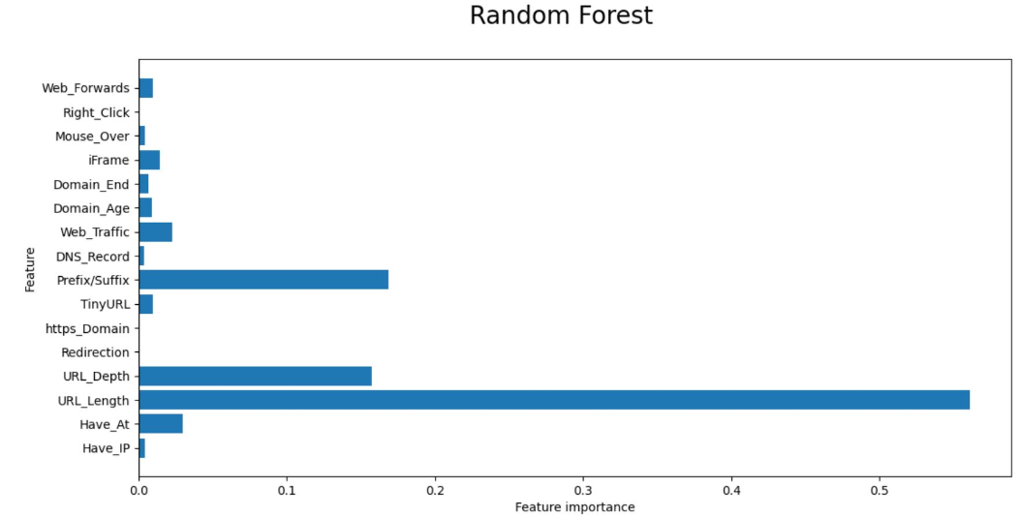
04
ML – Random Forest
A random forest is essentially a collection of decision trees, each tree is slightly different from the others. every tree might do a relatively good job of predicting, but will likely overfit on part of the data.
We can reduce the amount of overfitting by averaging the tees results.
The number of trees (the n_estimators parameter of RandomForestRegressor or RandomForestClassifier). They are very powerful, often work well without heavy tuning of the parameters, and don’t require scaling of the data.

Slide 15
Research Limitations
There are more than 1.8 Billion active websites (www.internetlivestats.com) my dataset is only a fraction of it.
The results of the study are relevant for this time. As the Internet world evolves at an accelerated pace it will be necessary to validate the research in the future er to keep the research up to date.

Slide 16
Improvements
In this research I used 2 algorithms with similar concepts. In future research I would like to combine different algorithms like KNN, Linear Regression or even a designed algorithm for phishing like “Multi-label rules for phishing classification” (www.sciencedirect.com)
I used only 16 characteristics. In the future more characteristics should be added like: SSL Cert, Open Ports and Number of links that lead to the site. More characteristics = more precise.

Slide 17
THANK YOU
Any Questions?

